Slide 1
Knee Osteoarthritis detection with severity grading
Name: Laxman B
Reg No: 19BCE1105
Guide: Dr.Sandeep Kumar Satapathy

Slide 2
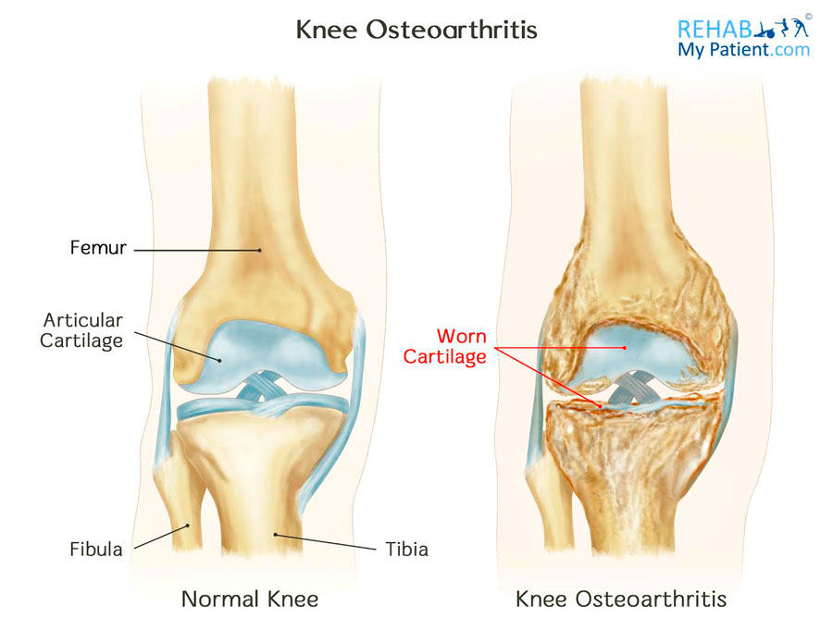
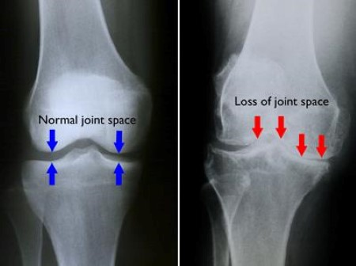
knee osteoarthritis
Knee osteoarthritis (KOA) is defined by degeneration of the knee’s articular cartilage the
flexible, slippery material that normally protects bones from joint friction and impact.

Slide 3
Image Classification based on severity using Kellgren-Lawrence (KL) grading system
Grade 0: Healthy knee image.
Grade 1 (Doubtful): Doubtful joint narrowing with possible osteophytic lipping
Grade 2 (Minimal): Definite presence of osteophytes and possible joint space narrowing
Grade 3 (Moderate): Multiple osteophytes, definite joint space narrowing, with mild sclerosis.
Grade 4 (Severe): Large osteophytes, significant joint narrowing, and severe sclerosis.

Slide 4
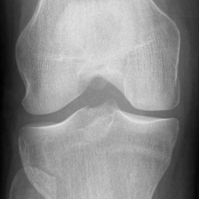
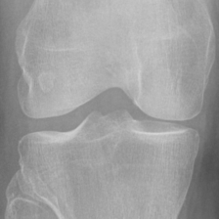
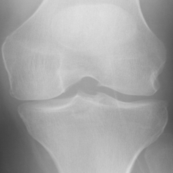
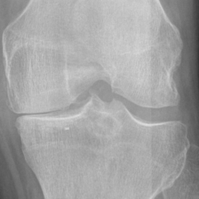
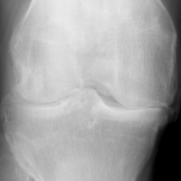
Grade 0
Grade 1
Grade 2
Grade 3
Grade 4

Slide 5
Why do we need to research on this topic?
Difficulties in early detection of KOA (stage 1, 2, 3) by doctors itself
Need for a reliable automatic grading assessment of KOA to replace to tedious and variable manual diagnosis
Great potential for machine learning/deep learning models to solve medical related problems

Slide 6
Problem Statement
To Detect Knee Osteoarthritis presence - (Yes / No) binary classification
Severity grading (0, 1, 2, 3, 4) - Multiclass classification
Predict Knee osteoarthritis with higher accuracy at early stage (1, 2, 3)

Slide 7
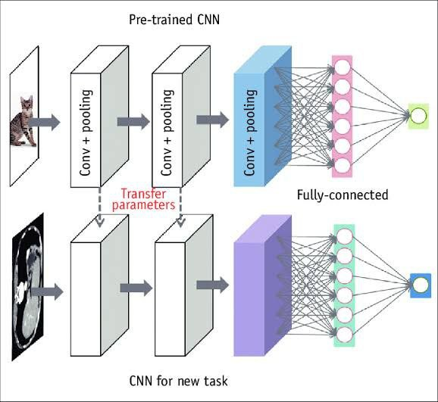
How do we solve?
Experimenting with machine learning models like SVM, KNN, etc.
Usage of CNN along with transfer learning models.

Slide 8
Time Line
Literature Review
Binary Classification
5 class classification (For KOA severity grading)
3 class classification (if accuracy of 5 classification is low)
Grade 0, 1 -> Normal
Grade 2, 3 -> Early KOA Detected
Grade 4 -> Severe KOA
Results, inference, architecture, outputs compilation
Research Paper

